Slide 1

Sales Insights – Data Analysis Project
(Using Power BI and SQL Server)
A Power BI Dashboard for Business Decision Making.
NAME: SRIKANTH MATCHA
Tools Used: Power BI, DAX, Excel/CSV, Data Modeling

Slide 2
📌 Project Overview
The Sales Insights Dashboard is an end-to-end data analysis project designed to help businesses monitor and understand their sales performance across different markets, customers, and products.
This project uses Power BI to transform raw sales data into interactive and actionable insights.
The goal is to help management identify:
✔ High-performing markets
✔ Top revenue-generating customers
✔ Best-selling products
✔ Monthly/Yearly revenue trends
✔ Overall business performance (Revenue & Sales Quantity)
This project demonstrates skills in data modeling, DAX measures, visualization, and storytelling, making it ideal for analytics portfolios and interviews.

Slide 3
Project Structure
1. Data Tables Used
sales_transactions – sales quantity, amount, date, market, customer
sales_customers – customer name & type
sales_products – product details
sales_markets – geographical zones & market name
sales_date – calendar table for time intelligence
Base Measures – Revenue & Sales Quantity
2. Data Modeling
A Star Schema was created:
Fact Table: sales_transactions
Dimension Tables: customers, markets, products, date
Relationships created as one-to-many with sales_transactions
This structure improves performance and enables time intelligence calculations.

Slide 4
Key Dashboard Features
1. KPI Cards
Total Revenue
Total Sales Quantity
2. Market Analysis
Revenue by Market
Sales Quantity by Market
3. Trend Analysis
Month-wise Revenue Trend (Line Chart)
Year & Month Slicers for filtering
4. Customer Insights
Top 5 Revenue-Generating Customers
5. Product Insights
Top 5 Best-Selling Products

Slide 5
Business Insights
Delhi NCR contributes the highest revenue to the business.
A few major customers drive most of the revenue (high dependency risk).
Revenue trend shows a decline in 2019–2020, indicating potential market issues.
Product sales are concentrated in a small number of SKUs.

Slide 6
Tools & Technologies
SQL Server (Data Source – imported tables into Power BI)
Power BI Desktop
Power Query (Data Cleaning & Transformation)
DAX (Measures for Revenue, Sales Quantity, KPIs)
Star Schema Data Modeling

Slide 7
Dataset Description
Table Name | Description | Key Columns
Customer | Contains customer details | Customer Name, Customer Type
Product | Product-level information | Product Code, Segment
Sales Transactions | All sales movement | Date, Sales Qty, Revenue
Market | Area and regions | Zone, Market Name

Slide 8
Data Cleaning & Preparation
Include points such as:
Removed duplicates & blank rows
Ensured correct data types (Date, Numeric, Text)
Handled missing values
Created relationships using primary/foreign keys
Built a star schema for better reporting
Generated DAX measures for dynamic insights (Revenue, Total Sales Qty, etc.)

Slide 9
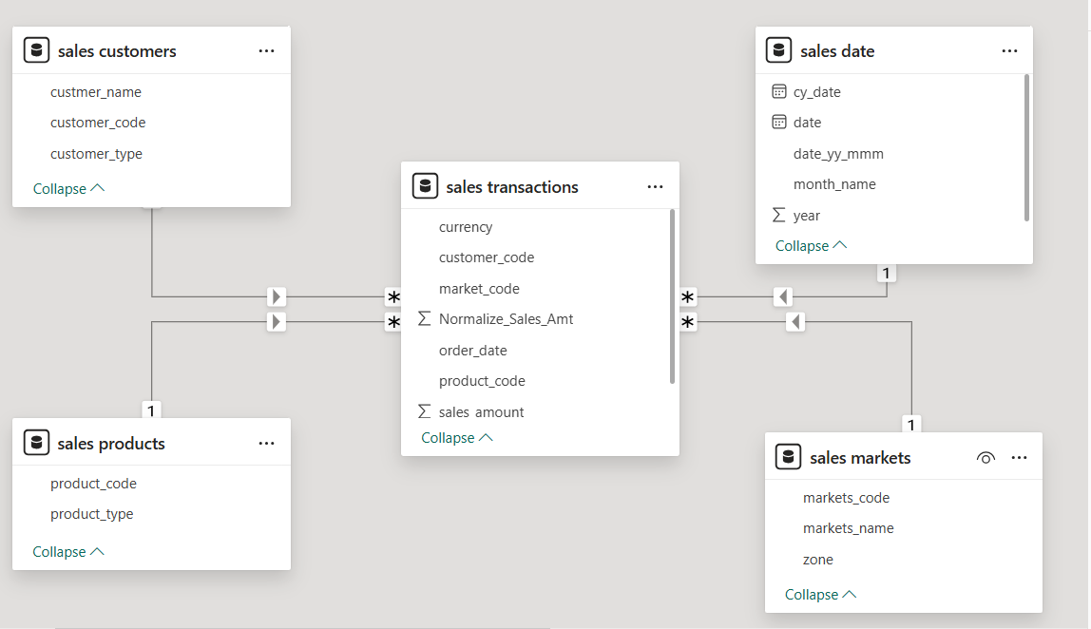
Data Model (Power BI)

Slide 10
Data Analysis Using SQL
Show all customer records
SELECT * FROM customers;
Show total number of customers
SELECT count(*) FROM customers;
Show transactions for Chennai market (market code for chennai is Mark001
SELECT * FROM transactions where market_code='Mark001';
Show distrinct product codes that were sold in chennai
SELECT distinct product_code FROM transactions where market_code='Mark001';
Show transactions where currency is US dollars
SELECT * from transactions where currency="USD"
Show transactions in 2020 join by date table
SELECT transactions.*, date.* FROM transactions INNER JOIN date ON transactions.order_date=date.date where date.year=2020;
Show total revenue in year 2020,
SELECT SUM(transactions.sales_amount) FROM transactions INNER JOIN date ON transactions.order_date=date.date where date.year=2020 and transactions.currency="INR\r" or transactions.currency="USD\r";
Show total revenue in year 2020, January Month,
SELECT SUM(transactions.sales_amount) FROM transactions INNER JOIN date ON transactions.order_date=date.date where date.year=2020 and and date.month_name="January" and (transactions.currency="INR\r" or transactions.currency="USD\r");
Show total revenue in year 2020 in Chennai
SELECT SUM(transactions.sales_amount) FROM transactions INNER JOIN date ON transactions.order_date=date.date where date.year=2020 and transactions.market_code="Mark001";

Slide 11
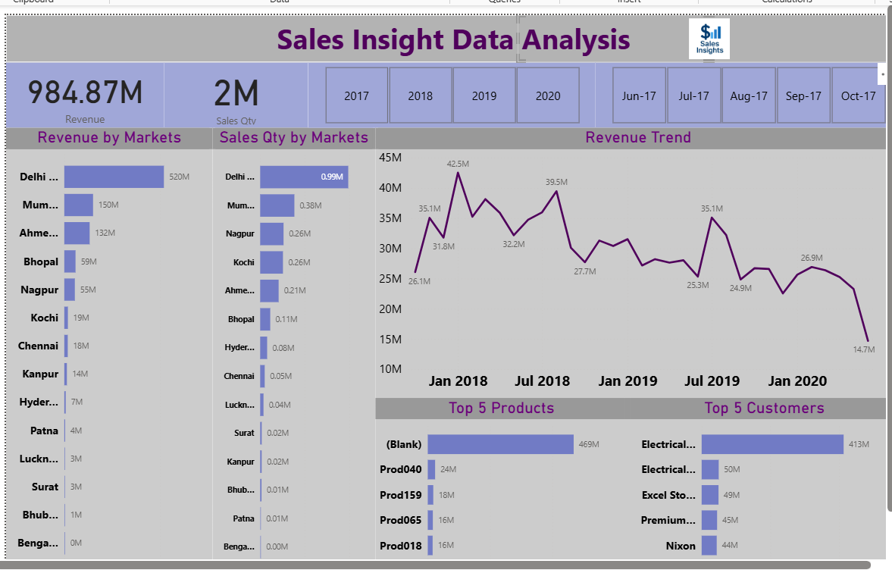
Dashboard Overview
The dashboard includes:
KPI cards (Revenue, Sales Qty)
Bar charts for top customers and Products
Line charts for trends
Slicers for dynamic filtering (Year, Market, Customer)

Slide 12
Conclusion
Conclusion
Sales performance is strong in specific regions
High dependence on a few major customers
Need to improve performance in underperforming markets
Dashboard helps leadership make faster, data-driven decisions

